Slide 1

Presented By ABHISHEK AMBASTA

Slide 2
Business Problem:
Walmart wants to optimize its sales strategies by analyzing historical transaction data across branches, customer types, payment methods, and product lines. To achieve this, advanced MySQL queries will be employed to answer challenging business questions related to sales performance, customer segmentation, and product trends.

Slide 3
Task 1: Top Branch by Sales Growth:
Walmart wants to identify which branch has exhibited the highest sales growth over time. Analyze the total sales for each branch and compare the growth rate across months to find the top performer.
APPROACH: Calculated monthly sales and growth using LAG(). Compared previous and current month to find average growth rate.
Query 1: Monthly Sales per Branch:
SELECT Branch,
DATE_FORMAT(STR_TO_DATE(Date, '%d-%m-%y'), '%Y-%m’)
AS SalesMonth,Sum(Total) AS MonthlySales
From Walmartsales_dataGroup By Branch,SalesMonth;
This Will Shows total sales per branch per month.

Slide 4

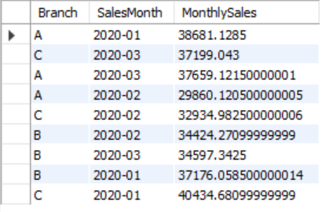
This Image shows Monthly sales Per Branch.
Query 2: Monthly Growth Rate Calculation:
SELECT Branch, SalesMonth, MonthlySales,LAG(MonthlySales)
OVER
(PARTITION BY Branch ORDER BY SalesMonth) AS PrevMonthSales,ROUND(IFNULL((MonthlySales- LAG(MonthlySales)OVER (PARTITION BY Branch ORDER BY SalesMonth)) / LAG(MonthlySales)OVER (PARTITION BY Branch ORDER BY SalesMonth) * 100,0),2)
AS GrowthRate
FROM
(SELECT Branch, DATE_FORMAT(STR_TO_DATE(Date,'%d-%m-%y'), '%Y-%m’)
AS SalesMonth,Sum(Total) AS MonthlySalesFrom Walmartsales_dataGroup By Branch,SalesMonth)AS MonthlyData;

Slide 5
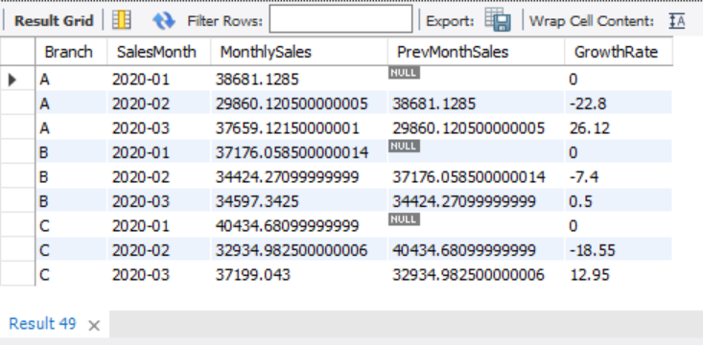
This Shows growth rate month by month for each branch, but this also have some null values that we are going to fix in the next and final query to find out TOP BRANCH by sales Growth.

Slide 6
Query 3: Average Growth Rate per Branch:
SELECT Branch, ROUND(AVG(GrowthRate), 2) AS AvgGrowthRate
FROM (SELECT Branch,SalesMonth,
ROUND(IFNULL((MonthlySales - LAG(MonthlySales)
OVER (PARTITION BY Branch ORDER BY SalesMonth)) / LAG(MonthlySales)
OVER (PARTITION BY Branch ORDER BY SalesMonth) * 100, 0), 2)
AS GrowthRate,
-- Needed to filter out first month–
LAG(MonthlySales) OVER (PARTITION BY Branch ORDER BY SalesMonth) AS PrevMonthSalesFROM (SELECT Branch, DATE_FORMAT(STR_TO_DATE(Date, '%d-%m-%y'), '%Y-%m') AS SalesMonth,SUM(Total) AS MonthlySalesFROM Walmartsales_data GROUP BY Branch, SalesMonth) AS MonthlyData) AS GrowthResultsWHERE PrevMonthSales IS NOT NULLGROUP BY BranchORDER BY AvgGrowthRate DESC;

Slide 7
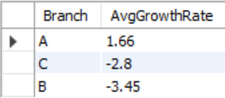
This shows that we have Calculated average growth rate per branch (ignoring nulls).
And this also Directly answers: Which branch showed the best overall sales growth.
INSIGHT: Branch A demonstrated the highest average monthly growth, signaling strong sales momentum.

Slide 8
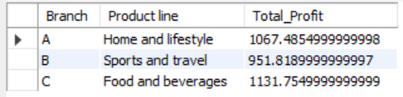
Task 2: Most Profitable Product Line per Branch
Approach: Grouped by Branch and Product line. Used SUM(gross income) and RANK() to get top
profitable product line per branch.
SELECT Branch, `Product line`, Total_Profit
FROM (SELECT Branch, `Product line`, SUM(`gross income`)
AS Total_Profit,
RANK() OVER
(PARTITION BY Branch ORDER BY SUM(`gross income`) DESC)
AS Profit_Rank
FROM Walmartsales_Data
GROUP BY Branch, `Product line`)
AS Ranked_Profit
Where Profit_Rank=1;

Slide 9
Branch | Product line | Total_Profit
A | Home and lifestyle | 1067.4855
B | Sports and travel | 951.819
C | Food and beverages | 1131.755
This Clearly Shows that Branch C has Product Line “Food and Beverages” that has Total Highest profit of 1131.75 followed by Branch A and B.

Slide 10
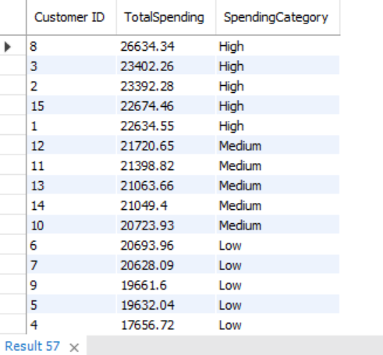
Task 3: Customer Segmentation
Approach : Used NTILE(3) to divide customers into High, Medium, and Low spenders based on total sales.
SELECT `Customer ID`, ROUND(TotalSpending, 2)
AS TotalSpending,
CASE
WHEN SpendingTier = 1 THEN 'Low'
WHEN SpendingTier = 2 THEN 'Medium’
WHEN SpendingTier = 3 THEN 'High’
END
AS SpendingCategory
FROM
(SELECT `Customer ID`,SUM(`Total`) AS TotalSpending,
NTILE(3) OVER (ORDER BY SUM(`Total`)) AS SpendingTier
FROM Walmartsales_data
GROUP BY `Customer ID`) AS Segmented
ORDER BY TotalSpending DESC;

Slide 11
Customer ID | TotalSpending | SpendingCategory
8 | 26634.34 | High
3 | 23402.26 | High
2 | 23392.28 | High
15 | 22674.46 | High
1 | 22634.55 | High
12 | 21720.65 | Medium
11 | 21398.82 | Medium
13 | 21063.66 | Medium
14 | 21049.4 | Medium
10 | 20723.93 | Medium
6 | 20693.96 | Low
7 | 20628.09 | Low
9 | 19661.6 | Low
5 | 19632.04 | Low
4 | 17656.72 | Low
This Shows the total Spending and their Spending category.
Customer Category | Sum of TotalSpending
High | 118737.89
Low | 98272.41
Medium | 105956.46
Grand Total | 322966.76
Insights and Suggestions: Customer category ‘High’ have more total spending followed by Medium and Low.
This allows targeted promotions and personalized campaigns.

Slide 12
Task 4: Detecting Anomalies in Sales Transactions
Approach: Used self join operation to compare each transaction's Total to its product line’s average.
Also defines anomalies as:
Transactions with Total > 150% of average or Total < 50% of average.
SELECT w.`Invoice ID`,w.`Product line`,w.`Total`,avg_tbl.AvgTotal,
CASE
WHEN w.`Total` > avg_tbl.AvgTotal * 1.5 THEN 'High Anomaly’
WHEN w.`Total` < avg_tbl.AvgTotal * 0.5 THEN 'Low Anomaly’
END AS AnomalyType
FROM `Walmartsales_data` w
JOIN (SELECT `Product line`, AVG(`Total`) AS AvgTotalFROM WalmartSales_dataGROUP BY `Product line`)AS avg_tbl
ON w.`Product line` = avg_tbl.`Product line`
WHERE avg_tbl.AvgTotal * 1.5
OR
avg_tbl.AvgTotal * 0.5;

Slide 13
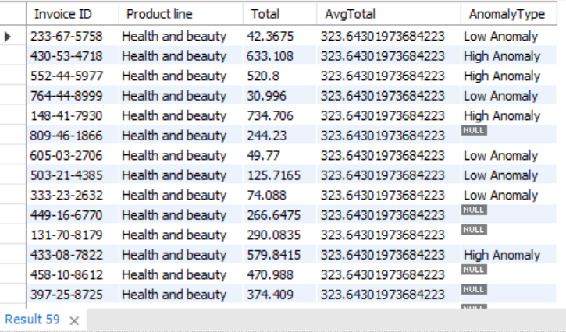
This is showing Null values If no Anomaly were found.
Insights and Suggestions: This helps in identifying errors, suspicious activity, or outlier behavior.

Slide 14
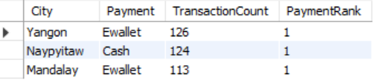
Task 5: Most Popular Payment Method by City.
Approach: First we will count how many times each payment method was used in each city.
Secondly we will use RANK to find the most used payment method Per city.
SELECT * FROM (
SELECT City,Payment,COUNT(*) AS TransactionCount,
RANK() OVER (PARTITION BY City ORDER BY COUNT(*) DESC) AS PaymentRank
FROM Walmartsales_data
GROUP BY City, Payment) AS ranked_payments
WHERE PaymentRank = 1
ORDER BY TransactionCount DESC;

Slide 15
City | Payment | TransactionCount | PaymentRank
Yangon | Ewallet | 126 | 1
Naypyitaw | Cash | 124 | 1
Mandalay | Ewallet | 113 | 1
Insights and suggestions: This clearly shows that Ewallets are most popular in Yangon and Mandalay, Cash remains dominant in Naypyitaw.
We can enables city-wise POS optimization.

Slide 16
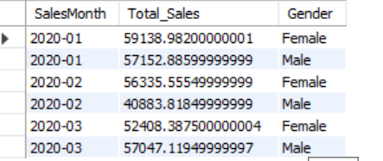
Task 6 : Monthly Sales Distribution by Gender.
Approach : We will Groups sales by month and gender then we will calculate the total sales for each gender in each month.
Select * From (
Select DATE_FORMAT(STR_TO_DATE(Date, '%d-%m-%y'), '%Y-%m') AS SalesMonth, Sum(`Total`) As Total_Sales ,Gender
FROM Walmartsales_Data
GROUP BY SalesMonth, Gender) AS sales_distribution
ORDER BY SalesMonth, Gender;

Slide 17
Year | Sum of Total_Sales
2020-01 | 116291.868
Female | 59138.982
Male | 57152.886
2020-02 | 97219.374
Female | 56335.5555
Male | 40883.8185
2020-03 | 109455.507
Female | 52408.3875
Male | 57047.1195
Grand Total | 322966.749
This analysis shows how monthly sales are split between male and female customers.
Insights and Suggestions:
It provides insight into gender-based purchasing patterns across months, enabling targeted campaigns and gender-sensitive promotions.

Slide 18
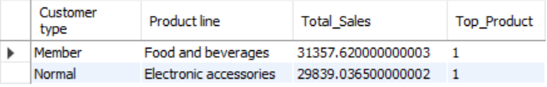
Task 7: Best Product Line by Customer Type
Approach : We will use Group By and Windows function to find out the best Product Line By Customer Type.
SELECT * FROM (
SELECT `Customer type`, `Product line`, SUM(`Total`) AS Total_Sales,
RANK() OVER (PARTITION BY `Customer type` ORDER BY SUM(`Total`) DESC)
AS Top_Product
From Walmartsales_data
GROUP BY `Customer type`, `Product line`) AS Best_Product_Line
WHERE Top_Product = 1
ORDER BY `Customer type`;

Slide 19
Customer type | Product line | Total_Sales | Top_Product
Member | Food and beverages | 31357.62 | 1
Normal | Electronic accessories | 29839.0365 | 1
Insights:
Members prefer Food and Beverages, while Normal customers spend the most on Electronic Accessories.

Slide 20
Task 8: Identifying Repeat Customers
Approach: We will use Windows Function LAG() to Compare the current purchase date with the previous or next one.
Also use DATEDIFF() to check the gap between transactions.
SELECT DISTINCT `Customer ID`
FROM (
SELECT `Customer ID`,STR_TO_DATE(Date, '%d-%m-%Y’)
AS PurchaseDate,
LAG(STR_TO_DATE(Date, '%d-%m-%Y')) OVER (PARTITION BY `Customer ID` ORDER BY STR_TO_DATE(Date, '%d-%m-%Y')) AS Previous_PurchaseDate
FROM walmartsales_data) AS Customer_dates
WHERE DATEDIFF(PurchaseDate, Previous_PurchaseDate) <=30
AND
Previous_PurchaseDate IS NOT NULL;

Slide 21
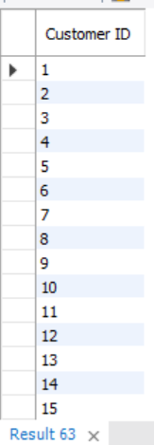
These customers made a repeat purchase within 30 days of their last one
Insights and Suggestions:
There are several customers made purchases within 30 days, indicating brand loyalty.
These can be enrolled in loyalty/rewards programs.

Slide 22
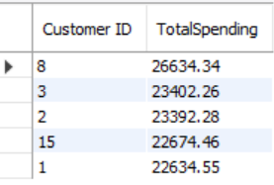
Task 9: Finding Top 5 Customers by Sales Volume
Approach: We will Group the data by Customer ID, then we will sum the Total for each customer.
Then we can arrange the total in descending order and Limit it by 5.
SELECT
`Customer ID`,
ROUND(SUM(`Total`), 2) AS TotalSpending
FROM Walmartsales_data
GROUP BY `Customer ID`
ORDER BY TotalSpending DESC
LIMIT 5;
Insights and Suggestions: Identified highest revenue-generating customers.
Perfect for exclusive offers or recognition marketing.

Slide 23
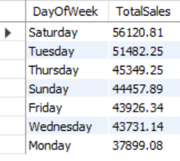
Task 10: Analyzing Sales Trends by Day of the Week
Walmart wants to know which days of the week bring in the most total sales revenue. This helps them plan promotions and staffing better.
Approach: We will First Extract the day of the Week using DAYNAME().
Then we will SUM the total sales for each day of the week.
After that finally we will Sort the results by total revenue (descending) — to see which day performs best.
SELECT DAYNAME(STR_TO_DATE(Date, '%d-%m-%Y')) AS DayOfWeek,
ROUND(SUM(Total), 2) AS TotalSales
FROM Walmartsales_data
GROUP BY DayOfWeek
ORDER BY TotalSales DESC;

Slide 24
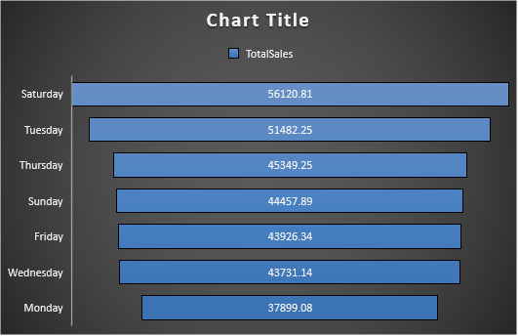
DayOfWeek | TotalSales
Saturday | 56120.81
Tuesday | 51482.25
Thursday | 45349.25
Sunday | 44457.89
Friday | 43926.34
Wednesday | 43731.14
Monday | 37899.08
Insights and Suggestion:
This clearly shows that Day of Week that is Saturday having the highest sales followed by Tuesday, Thursday, Sunday and so on
Useful for staff scheduling and weekend promotion strategy.

Slide 25
Final Conclusion:
Branch A showed the highest sales growth — indicating strong performance and potential for expansion.
Ewallet emerged as the most used payment method in Yangon and Mandalay — digital payment optimization is recommended.
Members preferred Food & Beverages, while Normal customers leaned toward Electronic Accessories — helping in tailoring marketing strategies.
Identified high-spending and repeat customers — can be nurtured through loyalty programs and exclusive offers.
Saturday generated the highest revenue— making weekends ideal for promotions and staffing adjustments.
Anomalous transactions were flagged using data thresholds — useful for fraud detection and quality control.
The project effectively used Advanced SQL techniques like RANK(), LAG(), NTILE(), and JOINS to convert RAW transaction data into strategic business insights.
These insights can help Walmart to optimize its marketing, improve customer experience, and boost operational efficiency.

